Slide 1
Monday 20th May
Faith ~ Excellence ~ Determination
Laudato Si/Feast of St Bede

Slide 2
Mission Statement
With the Lord’s help, we are united in faith, we strive for success and excellence, we are determined to be the best that we can be.
Faith ~ Excellence ~ Determination

Slide 3
We take a few moments of stillness to ready our hearts and minds.
In the name of the Father and of the Son and of the Holy Spirit. Amen

Slide 4
This weeks theme is Laudato Si/Feast of St Bede
In Laudato Si, we are urged by Pope Francis to look after the earth – Our Common Home.
God has given us the earth as our home. It’s our common home because we share it with everyone. We are a family and like every family we need to work together to look after our home.
In the first book of the Bible, we hear how God made the whole world, from the stars in the sky to the deepest oceans. People, land, water and mountains are all part of God’s wonderful creation and we have a responsibility to look after it all.
It is our school feast day on Saturday, so we will be taking part in a short celebration of the Word during Thursday tutor time.

Slide 5
Morning Prayer
Reader: In Pope Francis’ letter, he asks us to care for the earth by doing three things. Live wisely, think deeply and love generously. Let us pray together using a prayer based on St Francis’ words.
Reader: We thank you Lord for the earth which is our home. Help us to work together to protect the planet from harm.
Lord in your mercy – Hear our Prayer
Reader: We thank you Lord for water, which gives us life. Help us not to waste this precious resource.
Lord in your mercy – Hear our Prayer
Reader: We thank you Lord for all the plants and creatures you have given us. Help us to not do anything which causes them harm.
Lord in your mercy – Hear our Prayer.
Reader: We thank you Lord for all the people we share the world with. Help us to work together to take care of each other and our home, so that no one suffers.
Lord in your mercy – Hear our Prayer.

Slide 6
In the name of the Father and of the Son and of the Holy Spirit. Amen

Slide 7
Tuesday 21st May
Faith ~ Excellence ~ Determination
Laudato Si/Feast of St Bede

Slide 8
Mission Statement
With the Lord’s help, we are united in faith, we strive for success and excellence, we are determined to be the best that we can be.
Faith ~ Excellence ~ Determination

Slide 9
We take a few moments of stillness to ready our hearts and minds.
In the name of the Father and of the Son and of the Holy Spirit. Amen

Slide 10
Opening Prayer
As we gather this morning, we ask the Lord to be with us as we begin a new day.
Hail Mary, full of grace, The Lord is with thee; Blessed art thou amongst women and blessed is the fruit of thy womb Jesus.
Holy Mary, Mother of God, Pray for us sinners, now and at the hour of our death.
Amen

Slide 11
Reflection:
While all of creation was made for God’s pleasure, he put a special imprint on people when he created us. He made us in his image (1:26-27), which means that we reflect him. We resemble Him in certain characteristics and personality, we represent Him in creation, we communicate with him uniquely, and we can relate to Him in a special way. He gave us the role of looking after the earth and all the creatures on it.
Reading: A reading from Genesis 1:26-27
Glory to you O Lord
Then God said: "Let us make humankind in our image, according to our likeness; and let them have dominion over the fish of the sea, and over the birds of the air, and over the cattle, and over all the wild animals of the earth, and over every creeping thing that creeps upon the earth."
The Word of the Lord
Thanks be to God

Slide 12
In the name of the Father and of the Son and of the Holy Spirit. Amen

Slide 13
Wednesday 22nd May
Faith ~ Excellence ~ Determination
Laudato Si/Feast of St Bede

Slide 14
Mission Statement
With the Lord’s help, we are united in faith, we strive for success and excellence, we are determined to be the best that we can be.
Faith ~ Excellence ~ Determination

Slide 15
Let us put ourselves in the presence of God as we make the sign of the cross.
In the name of the Father and of the Son and of the Holy Spirit. Amen

Slide 16
Opening Prayer
As we gather this morning, let us pray together the prayer Our Father taught us:
Our Father, who art in Heaven, hallowed be Thy name;
Thy Kingdom come, Thy will be done, On earth as it is in Heaven.
Give us this day our daily bread; and forgive us our trespasses.
As we forgive those who trespass against us; and lead us not into temptation, But deliver us from evil
Amen

Slide 17
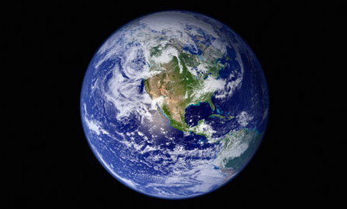
Reflection:
This short reading reminds us that God gave us a beautiful earth to live in, it is our responsibility to take care of it.
Reading: Psalm 115:16
Heaven belongs to the Lord, but the earth he has given to the human race.
The Word of the Lord
Thanks be to God

Slide 18
In the name of the Father and of the Son and of the Holy Spirit. Amen

Slide 19
Thursday 23rd May
Faith ~ Excellence ~ Determination
Laudato Si/Feast of St Bede

Slide 20
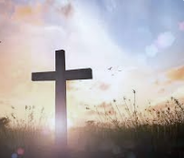
Feast of St Bede
Thursday 23rd May 2024

Slide 21
Good morning and welcome to this celebration of the Word. Let us put ourselves in the presence of God by making the Sign of the Cross together.

Slide 22
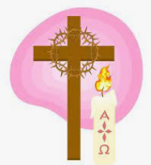
“In the name of the Father, and of the Son and of the Holy Spirit.”
Amen.

Slide 23
Let us pray together:
Good Jesus,
by your loving kindness,
enable me to come to you,
the fountain of wisdom,
and to stand forever before your face,
Amen
St Bede: Pray for Us

Slide 24
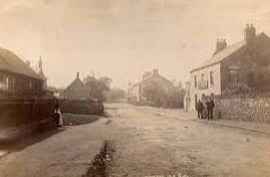
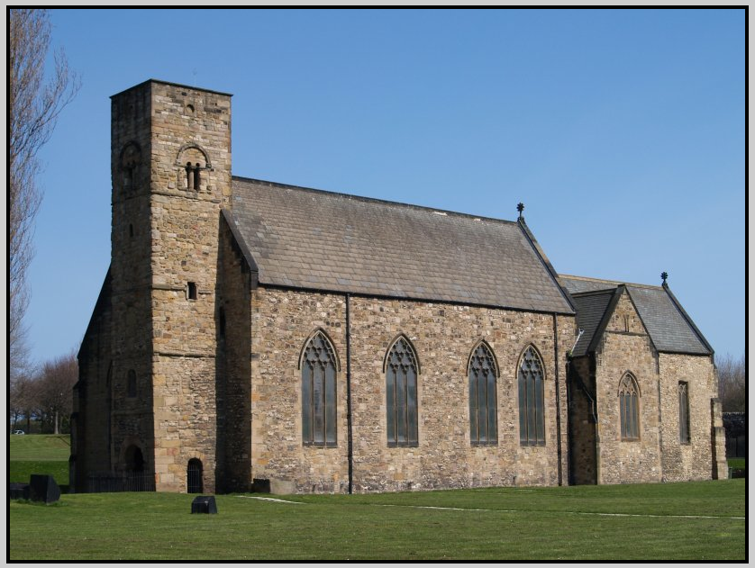
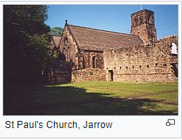
It is said that St Bede was born in Monkton in Jarrow in 673 AD, which is only 19 miles from here.
At the age of 7 he was entrusted to the care of Benedict Biscop who founded the monastery of St Peter at Wearmouth. He spent most of his life in the Monastery. By the age of 19 he had become a deacon and was promoted to Priest at 30.
St Bede was a keen scholar and started to write his first works in the year 701 AD. He continued writing for the rest of his life, and wrote over 60 books. He became known as the Venerable Bede and was widely regarded as the greatest of all the Anglo Saxon scholars.
St Bede died on the floor of his cell on Thursday, May 26 735 during the Feast of the Ascension. He died singing “Glory be to the Father and to the Son and to the Holy Spirit” and was buried at Jarrow. His feast day is celebrated on May 25th every year. St Bede listened to the God’s call.

Slide 25
A reading from the Gospel of John
Glory to you O Lord

Slide 26
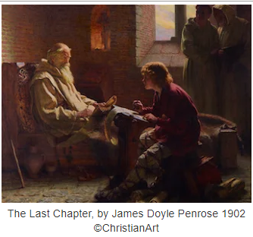
John 16:29-33
The disciples said to him, “Now you are speaking plainly and not in veiled language! Now we see that you know all things, even before we question you. Because of this we believe that you came from God.
Jesus answered them, “Do you believe now? The hour is coming, indeed it has come, when you will be scattered, each going his own way and you will leave me alone. Yet I am not alone, for the Father is with me. I have told you all this, so that in me you may have peace. In the world you will have suffering. But take courage! I have overcome the world.”

Slide 27
The Gospel of the Lord.
Praise to you Lord Jesus Christ

Slide 28
Bidding Prayers:
Let us pray that St Bede can help us find the right path and rule for our lives.
Allow us to live a good life following his example.
Lord in your mercy
Hear our prayer
We pray for all the current and former students of St Bede’s, that we are all able to find happiness and success in life with the guidance of the Holy Spirit. May we have the strength and courage to deal with difficulties we may face in life.
Lord in your mercy
Hear our prayer
Let us pray for all those who are sick at this time and for members of our families who have passed away in your light. We pray for the sick to recover and those who have passed away to find their eternal rest with you in heaven.
Lord in your mercy
Hear our prayer

Slide 29
Let us pray for all those who are taking important examinations at this time. We pray that they get the results they deserve.
Lord in your mercy
Hear our prayer
We offer these prayers to Mary our Mother in Heaven as we say
Hail Mary, Full of Grace,
The Lord is with thee.
Blessed art thou among women, and blessed is the fruit of thy womb, Jesus.
Holy Mary, Mother of God, pray for us sinners now, and at the hour of our death
Amen

Slide 30
Going forth:
St Bede was a scholar and believed in education. As you leave today, try to live out our schools mission statement as he would have wanted us to.

Slide 31
Have faith
Try to be excellent
Be determined in all that you do.
With the Lord’s help, we are united in faith, we are determined to achieve and strive for success and excellence in all that we do.

Slide 32
In the name of the Father and of the Son and of the Holy Spirit. Amen

Slide 33
Friday 24th May
Faith ~ Excellence ~ Determination
Laudato Si/Feast of St Bede

Slide 34
Let us begin our day together in the presence of the Lord.
In the name of the Father and of the Son and of the Holy Spirit. Amen

Slide 35
This week we have thought about the importance of taking care of the world in which we live. Let us remember that we only have one world and we need to look after it. We also celebrated our Feast Day a little earlier as that day is tomorrow. Remember that St Bede was a scholar and saw education as being very important.
Let us join together in prayer.

Slide 36
We thank you Lord for the earth which is our home. Help us to work together to protect the planet from harm.
Lord in your mercy
Hear our prayer.
We thank you Lord for water which gives us life. Help us not to waste this precious resource.
Lord in your mercy
Hear our prayer
We thank you Lord for all the plants and creatures you have given us. Help us to not do anything which causes them harm.
Lord in your mercy
Hear our Prayer
We thank you Lord for all the people we share the world with. Help us to work together to take care of each other and our home, so that no one suffers.
Lord in your mercy
Hear our prayer.

Slide 37
Closing prayer
Our Father, who art in Heaven, hallowed be Thy name;
Thy Kingdom come, Thy will be done, On earth as it is in Heaven.
Give us this day our daily bread; and forgive us our trespasses.
As we forgive those who trespass against us; and lead us not into temptation, But deliver us from evil
Amen
St Bede,
Pray for us

Slide 38
In the name of the Father and of the Son and of the Holy Spirit. Amen

